Slide 1
Urban Futures Symposium 2025 Oral presentation template
Urban Futures Symposium 2025 Dubendorf, September 01 – 02, 2025
First name A Last Name A¹, First Name B Last Name B², …
1
e.g., Urban Energy Systems Laboratory, Empa, Switzerland

Slide 2
Urban Futures Symposium 2025 Oral presentation template
Urban Futures Symposium 2025 Dubendorf, September 01 – 02, 2025
First name A Last Name A¹, First Name B Last Name B², …
1
e.g., Urban Energy Systems Laboratory, Empa, Switzerland

Slide 3
Urban Futures Symposium 2025 Oral presentation template
Urban Futures Symposium 2025 Dubendorf, September 01 – 02, 2025
First name A Last Name A¹, First Name B Last Name B², …
1
e.g., Urban Energy Systems Laboratory, Empa, Switzerland

Slide 4
Urban Futures Symposium 2025 Oral presentation template
Urban Futures Symposium 2025 Dubendorf, September 01 – 02, 2025
First name A Last Name A¹, First Name B Last Name B², …
1
e.g., Urban Energy Systems Laboratory, Empa, Switzerland

Slide 5
Urban Futures Symposium 2025 Oral presentation template
Urban Futures Symposium 2025 Dubendorf, September 01 – 02, 2025
First name A Last Name A¹, First Name B Last Name B², …
1
e.g., Urban Energy Systems Laboratory, Empa, Switzerland

Slide 6
Urban Futures Symposium 2025 Oral presentation template
Urban Futures Symposium 2025 Dubendorf, September 01 – 02, 2025
First name A Last Name A¹, First Name B Last Name B², …
1
e.g., Urban Energy Systems Laboratory, Empa, Switzerland

Slide 7
How to use the template
2.
You can use your own or this template for your oral presentation at the UFS!
To personalize it, please follow these steps:
Fill in the title slide and final slide
Insert your home institution logo in the upper right corner of the slides

Slide 8
Information on the program and template
You are free to use this template or your own template for your oral presentation at the Urban Futures Symposium
The presentations consist of
10 min oral presentation (maximum)
4 min questions from the audience (maximum)
You can find information on your assigned time slot and location here:
https://urban-futures.empa.ch/symposium-program

Slide 9
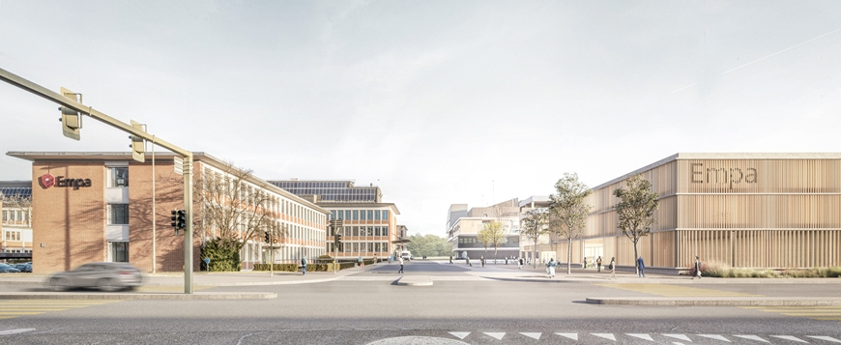
Example slide 01 Full image of Empa Dubendorf campus

Slide 10
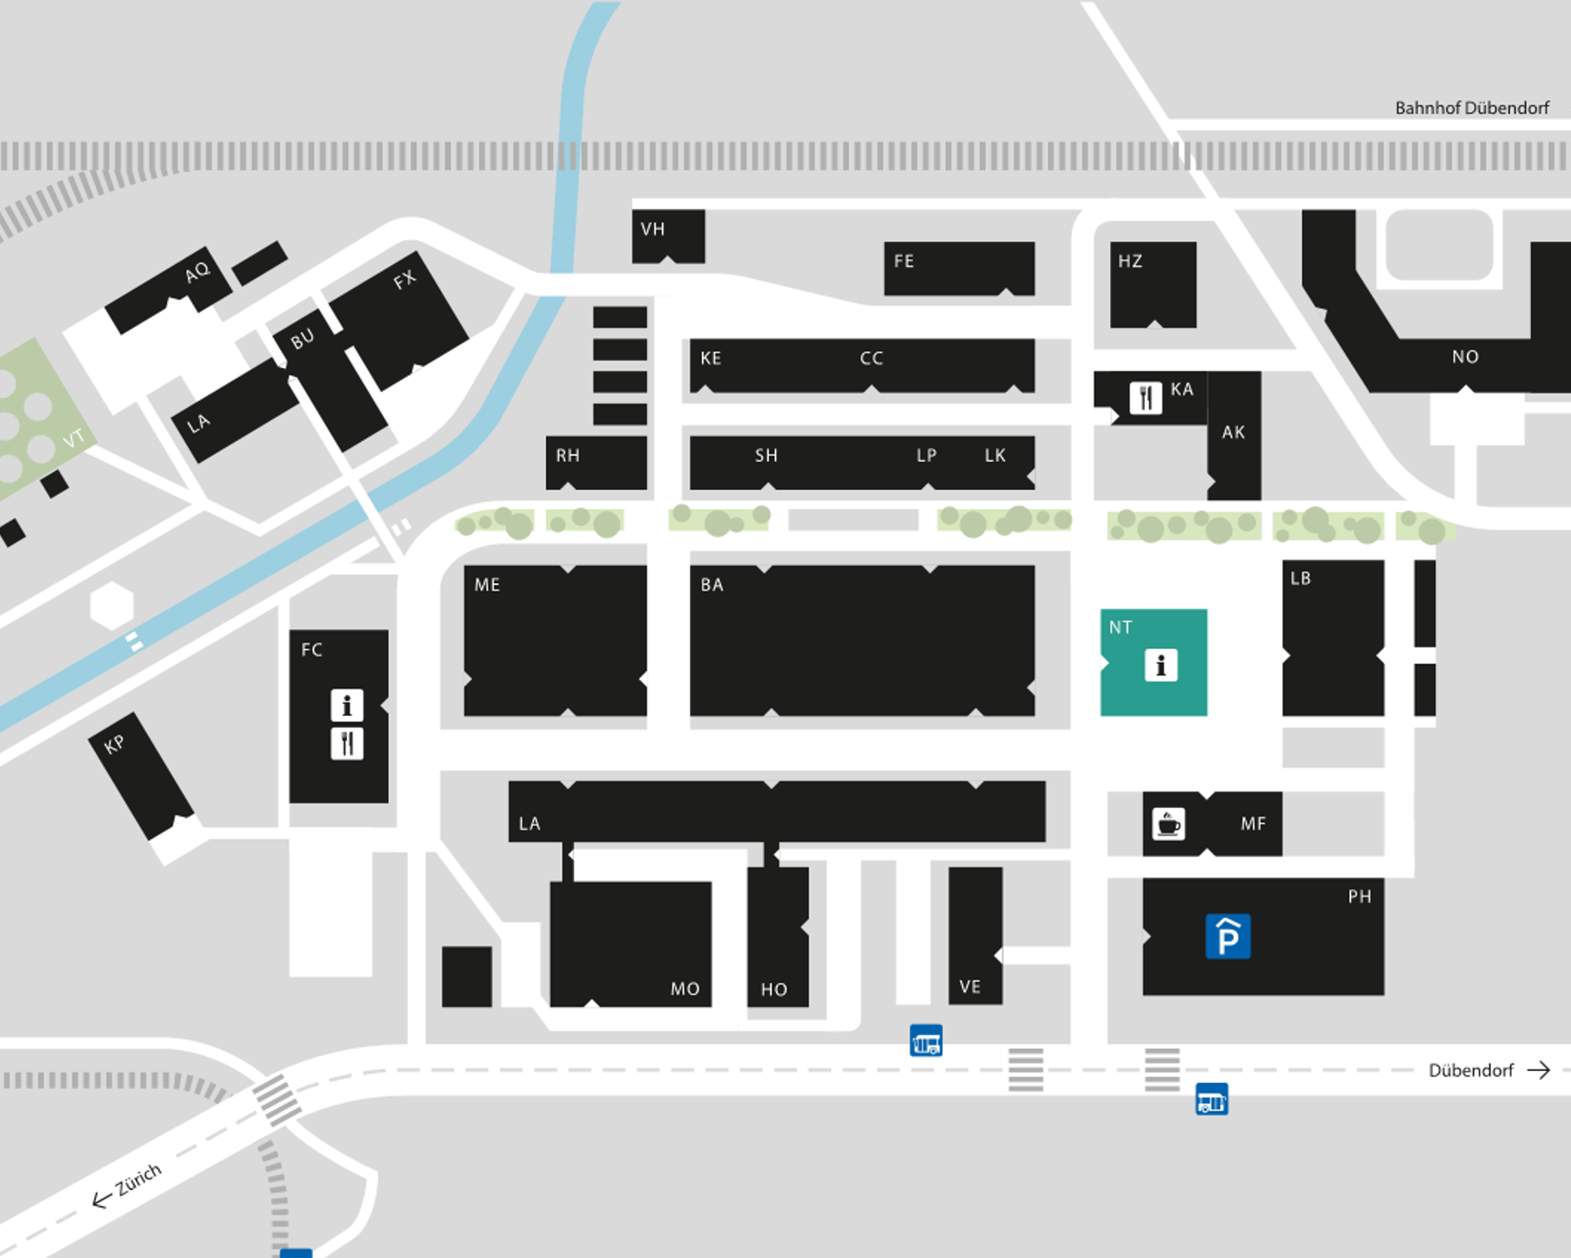
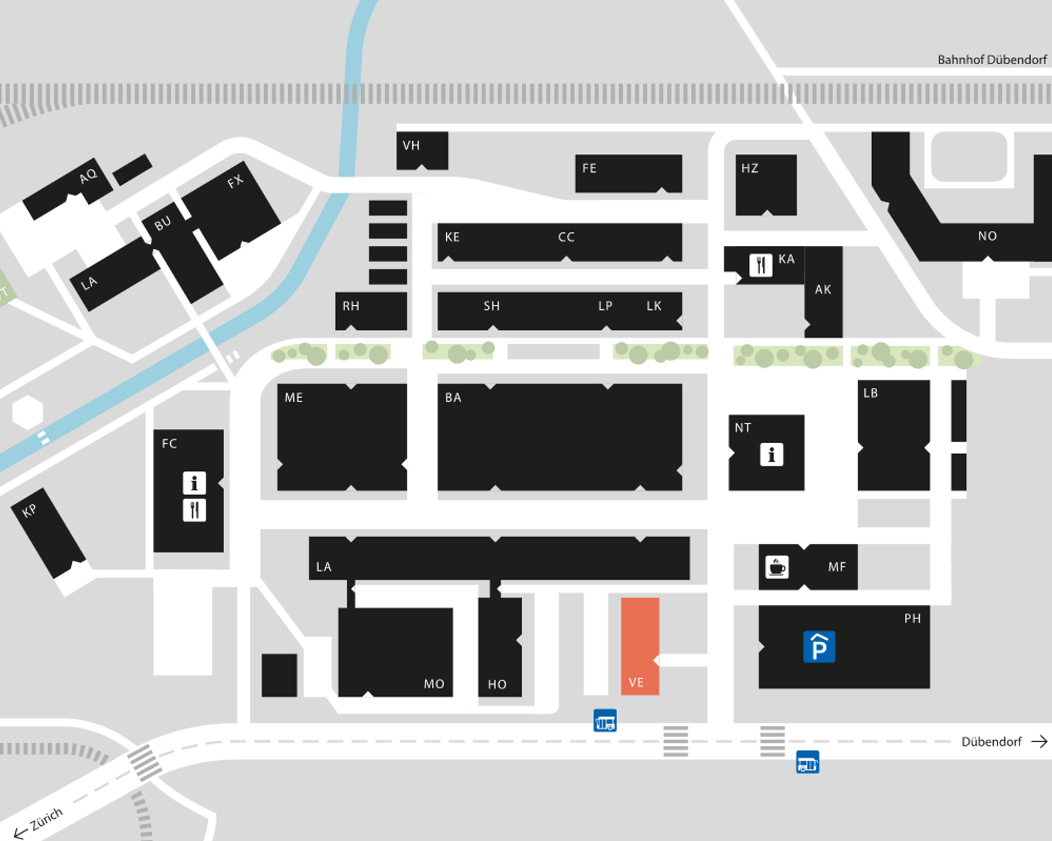
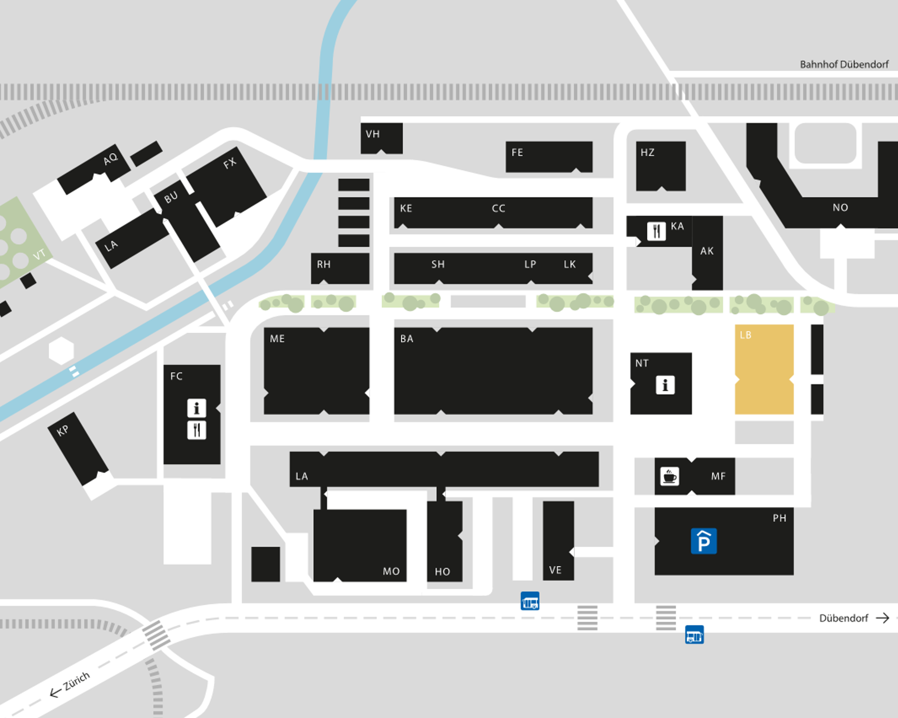
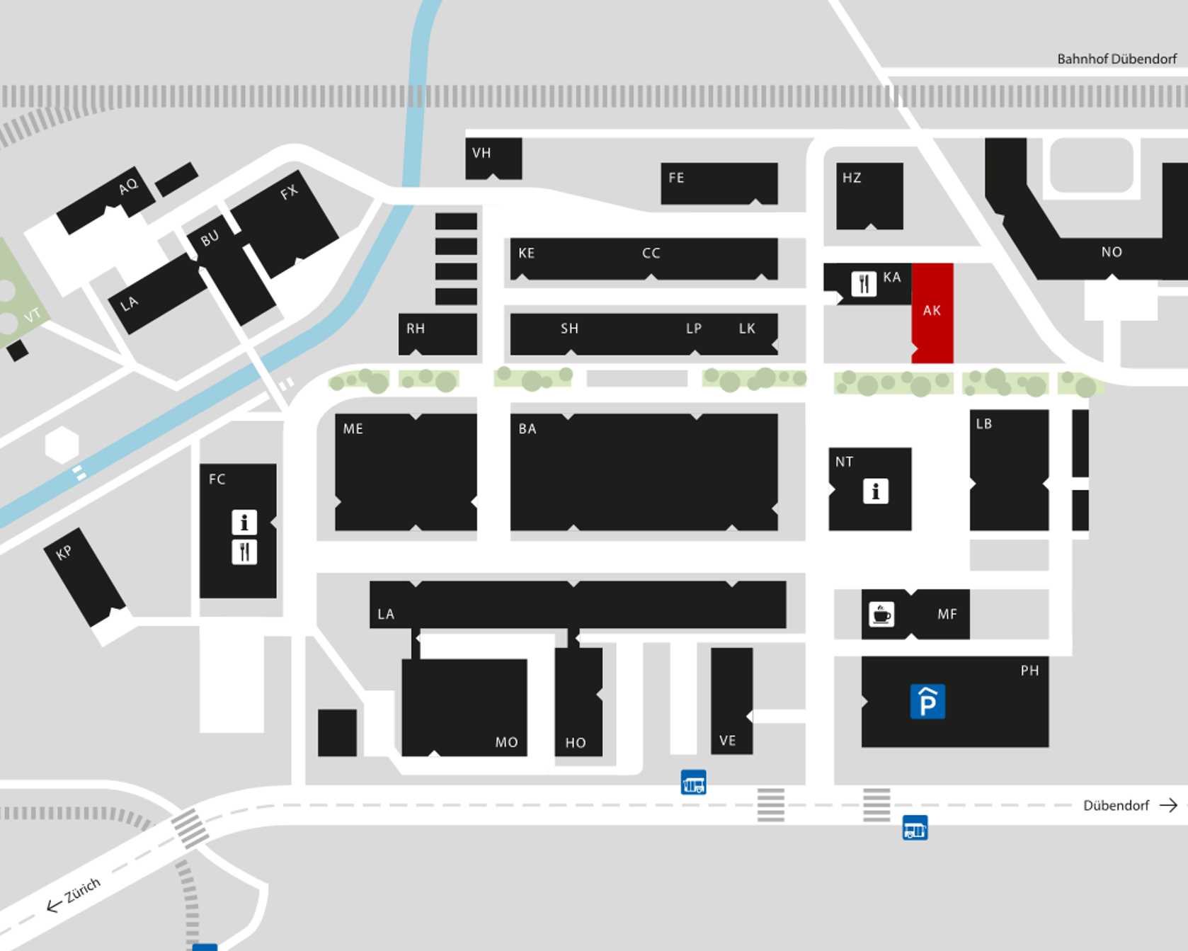
Example slide 02 UFS conference venue
NEST building
VE building
LB building
Akademie
The conference will take place at the NEST building, VE building, LB building and the Akademie on the Empa Dubendorf campus
Lunch will take place at Akademie Foyer

Slide 11
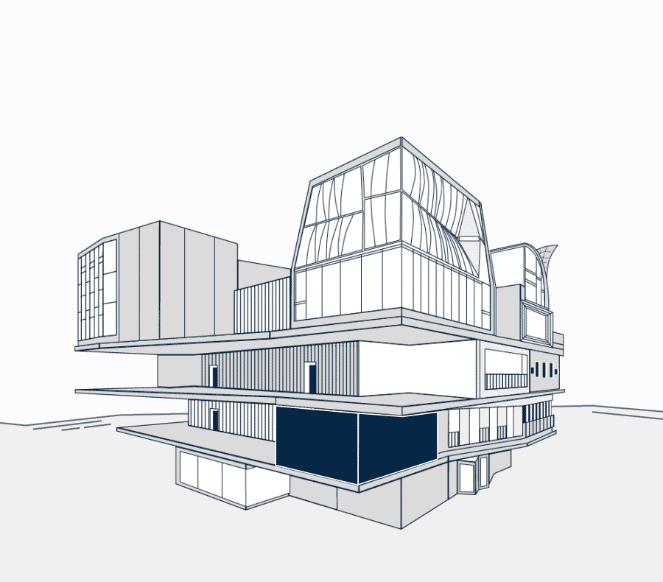
Example slide 03 Text and diagrams
Please do not overcrowd your slides!
Use illustrations generously
A good rule of thumb is the 7x7-rule
No more than seven words per line
No more than seven lines per slide

Slide 12
Urban Futures Symposium 2025 Oral presentation template
Urban Futures Symposium 2025 Dubendorf, September 01 – 02, 2025
First name A Last Name A¹, First Name B Last Name B², …
1
e.g., Urban Energy Systems Laboratory, Empa, Switzerland

