Slide 1


Highly Recycled Asphalt Pavement
Martins Zaumanis
31.12.2023

Slide 2
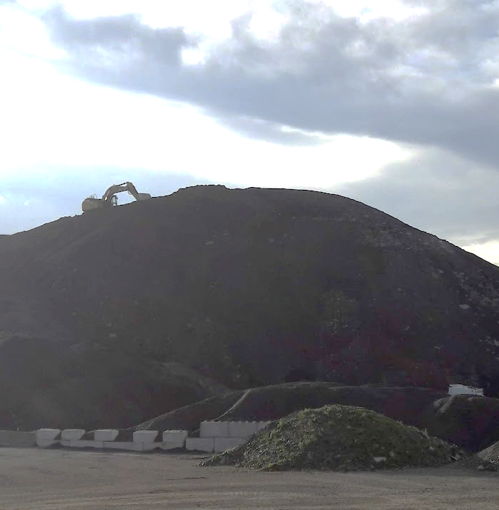
Annually 750,000 t of Reclaimed Asphalt Pavement (RAP) are not re-used in Switzerland

Slide 3

Objective
Develop recommendations that would allow increasing the average reclaimed asphalt content in asphalt production without compromising the pavement performance.

Slide 4
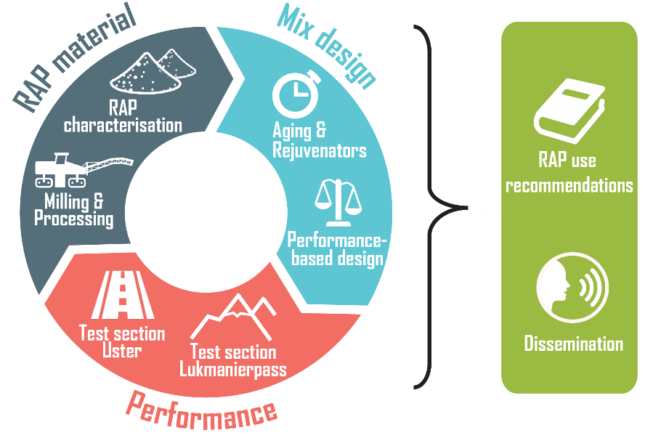





HighRAP project overview
Participants
Sponsors
Bundesamt für Strassen Bundesamt für Umwelt AWEL Kanton Zürich ANU Kanton Graubünden
Duration: 06.2019-12.2022

Slide 5
Project participants
Principal investigator
Martins Zaumanis, Empa, Concrete and Asphalt Laboratory
Participants
Lily Poulikakos, Empa, Concrete and Asphalt Laboratory
Lukas Boesiger, Ammann Schweiz AG
Bernhard Kunz, BHZ AG
Henry Mazzoni, Catram AG
Peter Bruhin, Catram AG
Dominique Lötscher, Reproad AG
Urs Schellenberg, Kanton Zürich
Voluntary Contribution
Gion Dosch, Tiefbauamt Graubünden
Gabriel-Martin Elekes, TBA Graubünden
Viele andere
Monitoring committee
President
Fabian Traber, Bundesamt für Strassen (ASTRA)
Participants
David Hiltbrunner, Bundesamt Für Umwelt (BAFU)
Remo Fehr, Amt für Natur und Umwelt - Kanton Graubünden
Dominik Oetiker, Amt für Abfall, Wasser, Energie und Luft – Kanton Zürich
Christoph Gassmann, Baudirektion Kanton ZH Tiefbauamt
Nicolas Bueche, Bern University of Applied Sciences (BFH)

Slide 6
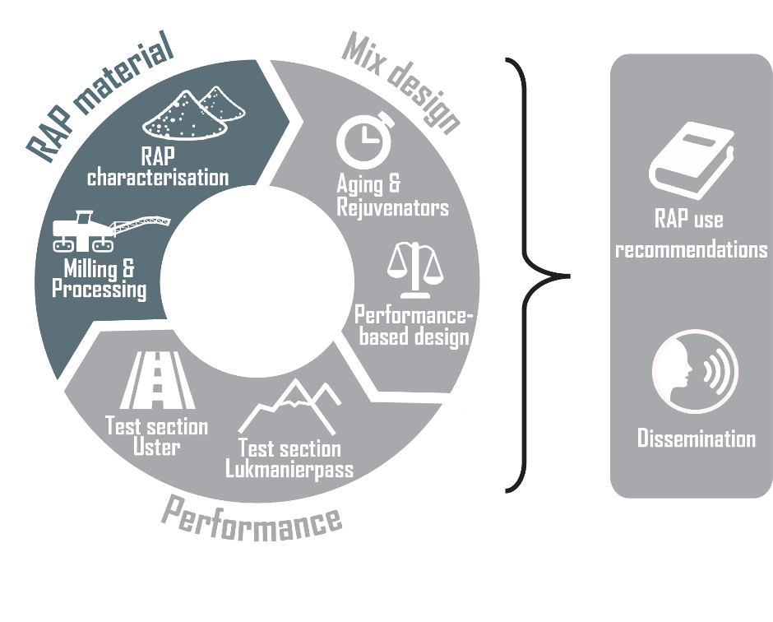
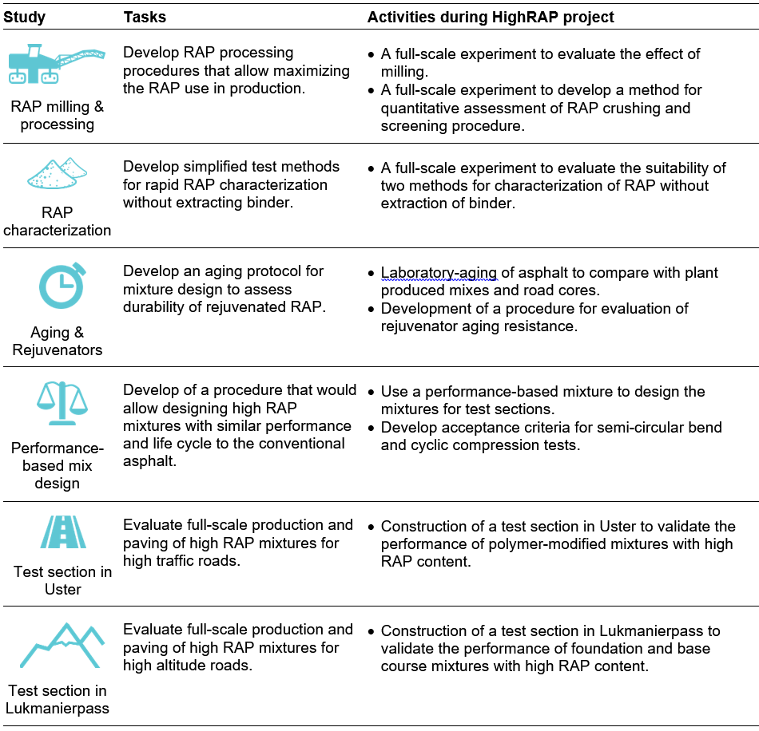
RAP Material: RAP Processing

Slide 7
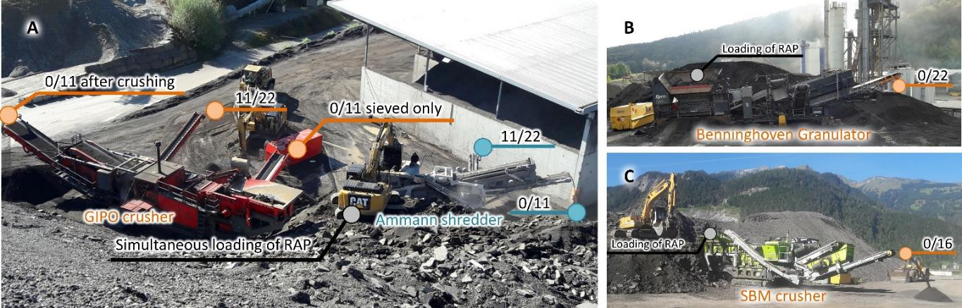
Four different crushers were used for the experiment

Slide 8
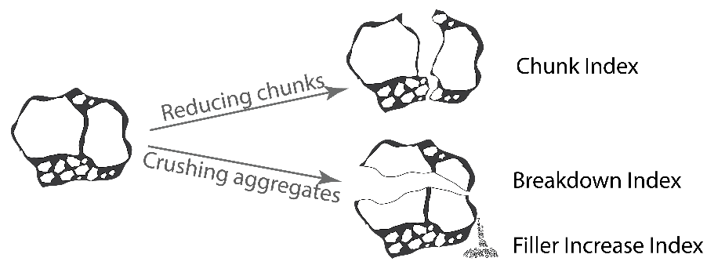
Three indexes that allow evaluating crushing and screening of RAP were developed:
Chunk Index demonstrates the size of RAP agglomerations.
Breakdown Index demonstrates the reduction of RAP aggregate particle size during processing.
Filler Increase Index reflects the amount of generated filler content during RAP processing.

Slide 9
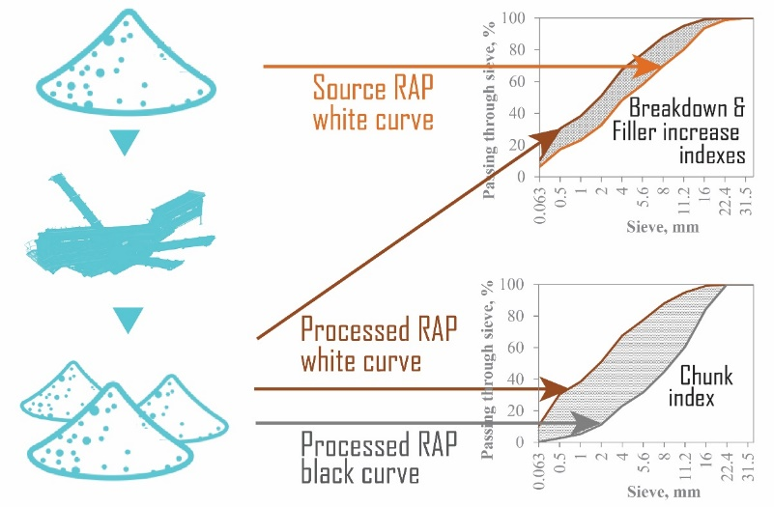
The indexes can be determined using gradation analysis of RAP before and after binder extraction.

Slide 10
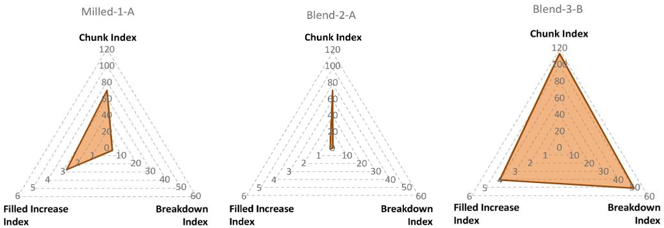
A radar chart allows comparing different RAP crushing methods and optimize the crusher parameters
Smaller area = better RAP processing

Slide 11

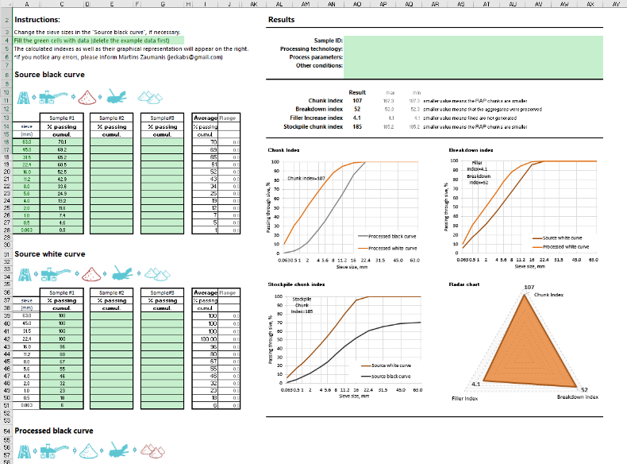
Calculator is available for download: https://doi.org/10.5281/zenodo.5500154

Slide 12

RAP Material: RAP milling

Slide 13
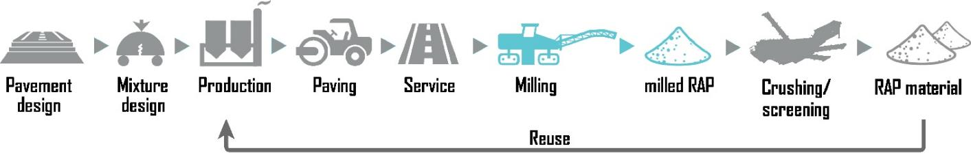
Why do we need to research milling?
Milling is most often viewed from the process perspective, for example by optimizing pavement removal speed, milling depth, machine wear, energy use, and other parameters.
There is almost no research on how milling affects the RAP properties.
RAP is an important material for asphalt production.

Slide 14
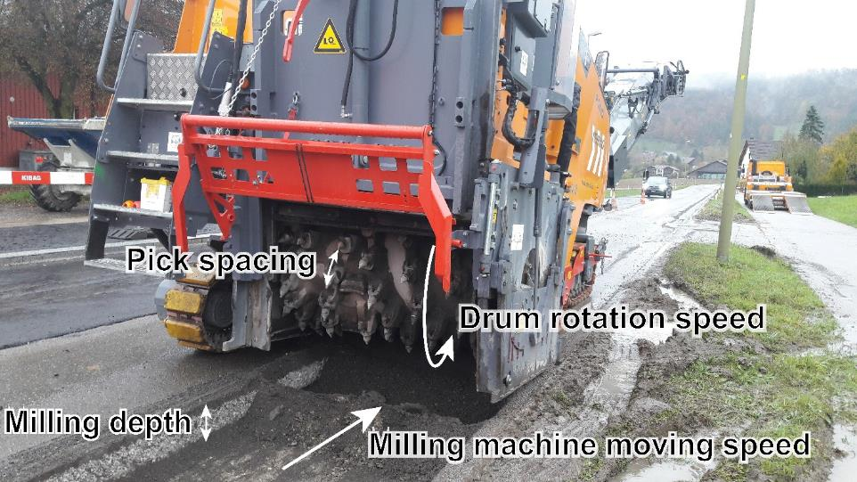
The idea: Milling parameters impact the RAP properties. But which parameters and how?

Slide 15
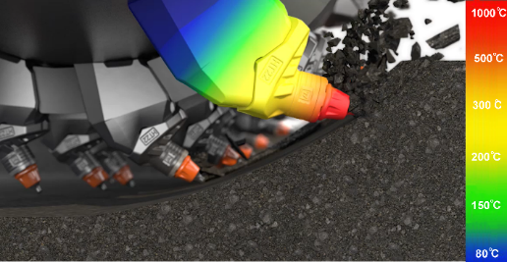
Result: milling does not age binder
(illustration courtesy of Wirtgen)

Slide 16
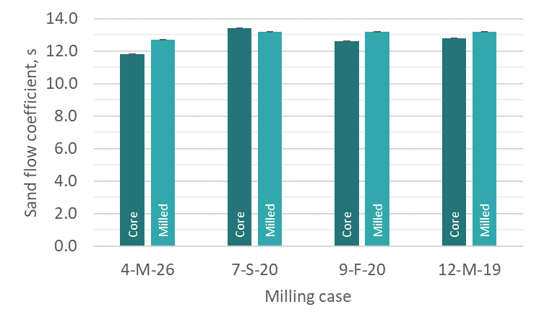
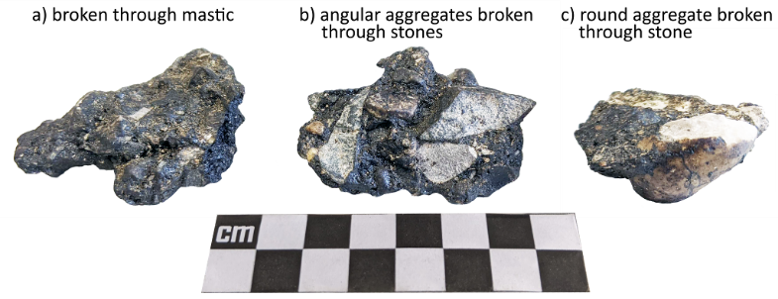
Result: The aggregate angularigy is not impacted by milling

Slide 17
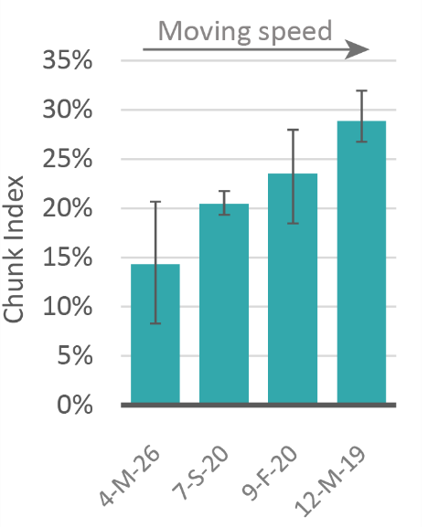
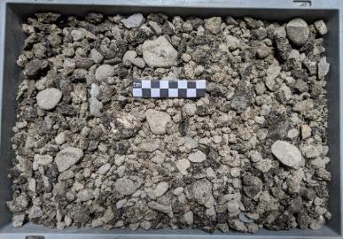
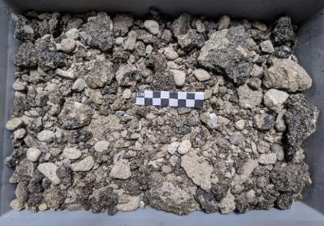
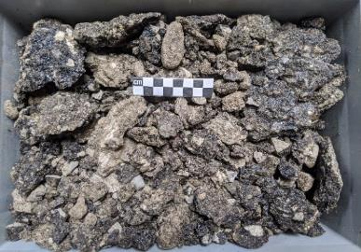
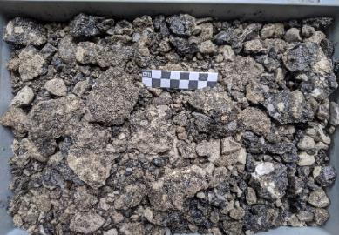
Result: The size of RAP agglomerations increase with higher milling speed
4-M-26 (Chunk Index = 14.3%)
7-S-20 (Chunk Index = 20.5%)
9-F-20 (Chunk Index = 23.5%)
12-M-19 (Chunk Index = 28.9%)

Slide 18
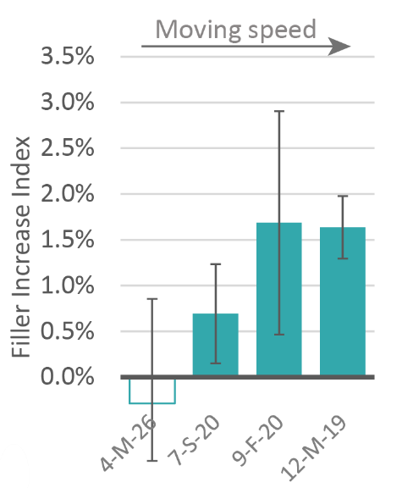
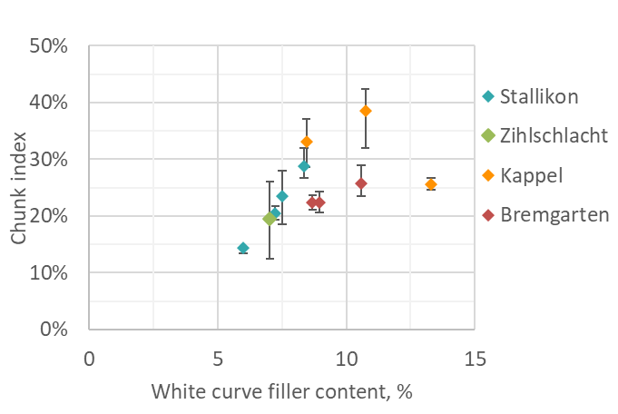
Result: less filler is generated at lower milling speed

Slide 19
RAP Material: RAP Characterization

Slide 20
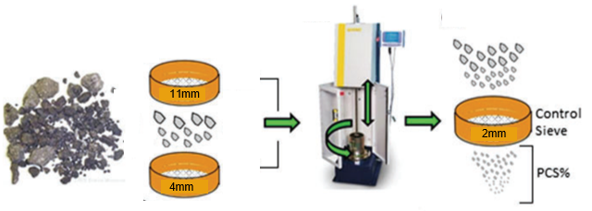
Fragmentation test
Recommended by RILEM
Tested at 20 °C
150 mm molds
56 Blows (5 layers)
3 kg of material
Result = Passing through control sive (PCS), %

Slide 21
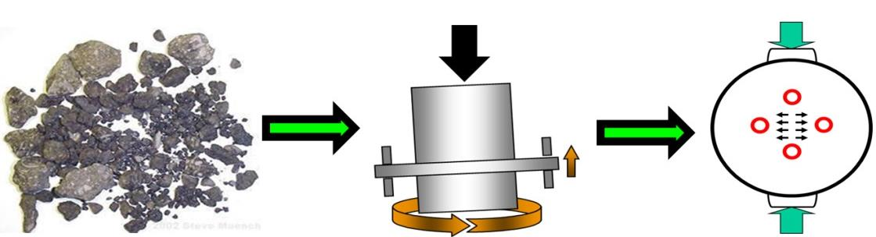

Cohesion test
Recommended by RILEM
RAP compacted at 140 °C using gyratory compactor (150 mm mold)
Indirekt Tensile Test at 25 °C
Result = Indirect tensile strength
Result = N_{flex}Factor
$$N_{flex}Factor=\frac{Tughness to inflection point, kPa}{postpeak slope at inflection point, kPa}$$

Slide 22
Result Summary
Fragmentation test
High Repeatability
Sensitive to RAP processing method
Effect of RAP agglomerations and aggregate toughness could not be established
Cohesion test
Sesntive toward bitumen softening point
Sensitive toward bitumen aging
Not sensitive toward bitumen content
None of the tests is ready for implementation
Further research is necessary

Slide 23
RAP-Variability
Tasks | Activities during HighRAP project
Determine the impact of RAP homogeneity | A theoretical calculation to determine the impact of RAP homogeneity based on the RAP content in mixture

Slide 24
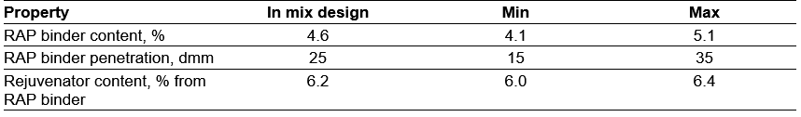
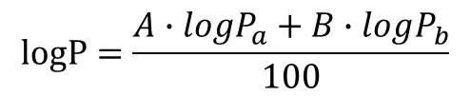
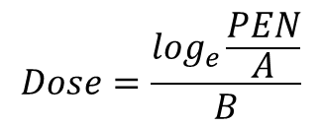
Assumed RAP variability (but representative of praxis)
Calculation of bitumen penetration
Calculation of rejuvenator effect
$$Dose=\frac{\log_{e}\frac{PEN}{A}}{B}$$
$$logP=\frac{A∙logP_{a}+B∙logP_{b}}{100}$$

Slide 25
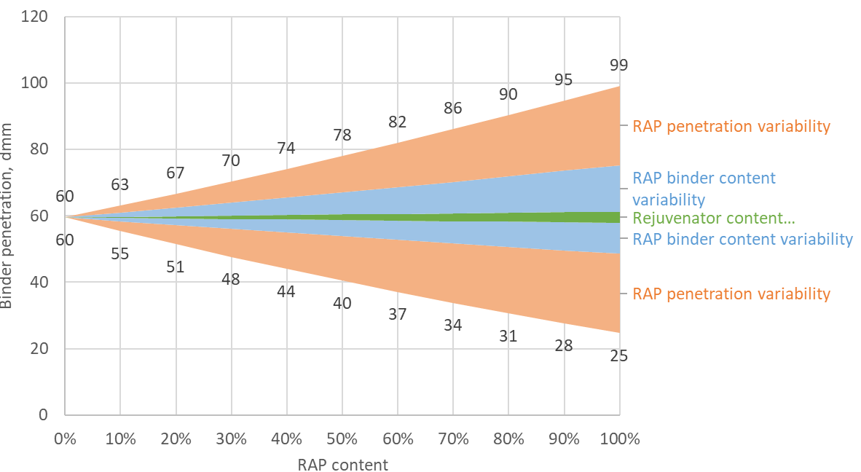
Variability of RAP binder penetration depending on the RAP content

Slide 26
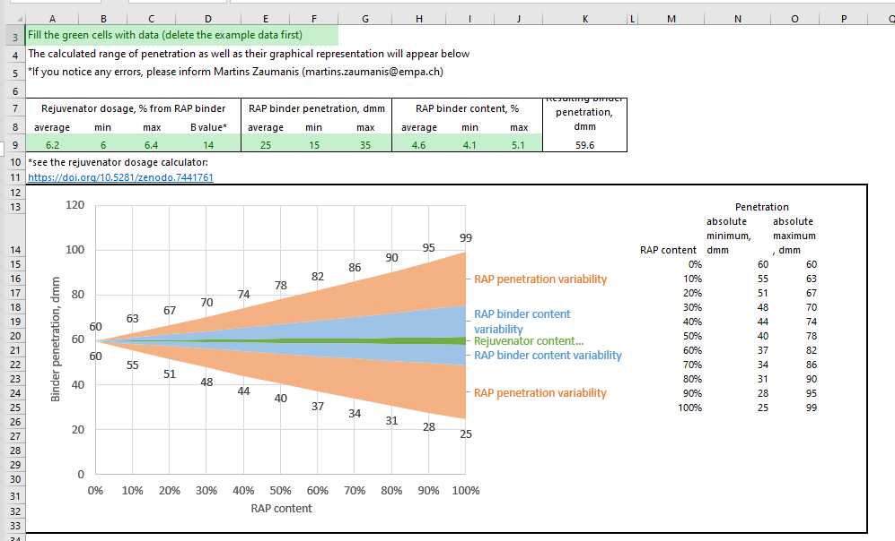
RAP variability calculator available: https://doi.org/10.5281/zenodo.7441805

Slide 27
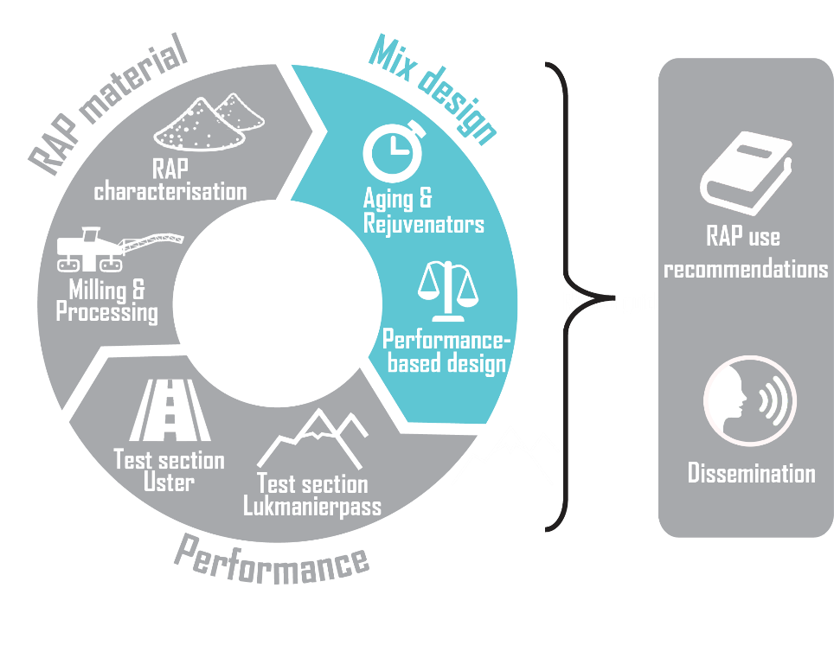
Mix design: Rejuvenators

Slide 28
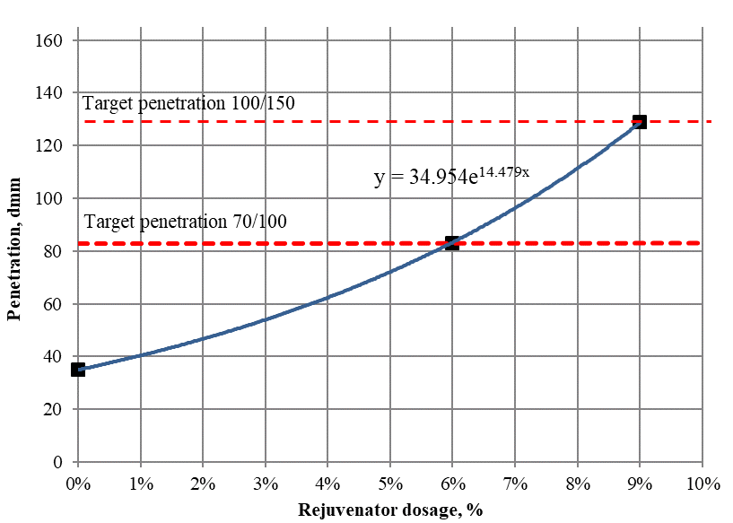
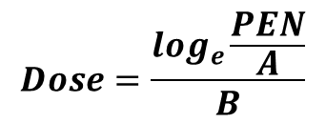
Rejuvenator dosage to reach the penetration of target grade
Step 1:
$$Dose=\frac{\log_{e}\frac{PEN}{A}}{B}$$

Slide 29
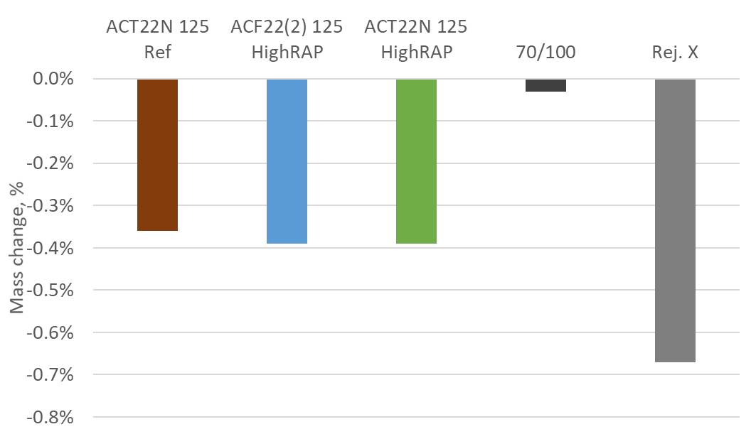
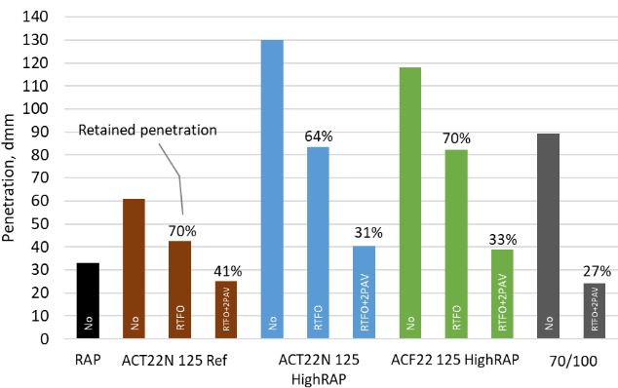
Determine aging resistance
Step 2:
1) Mass change after RTFO aging
2) Penetration after RTFO + 2PAV

Slide 30
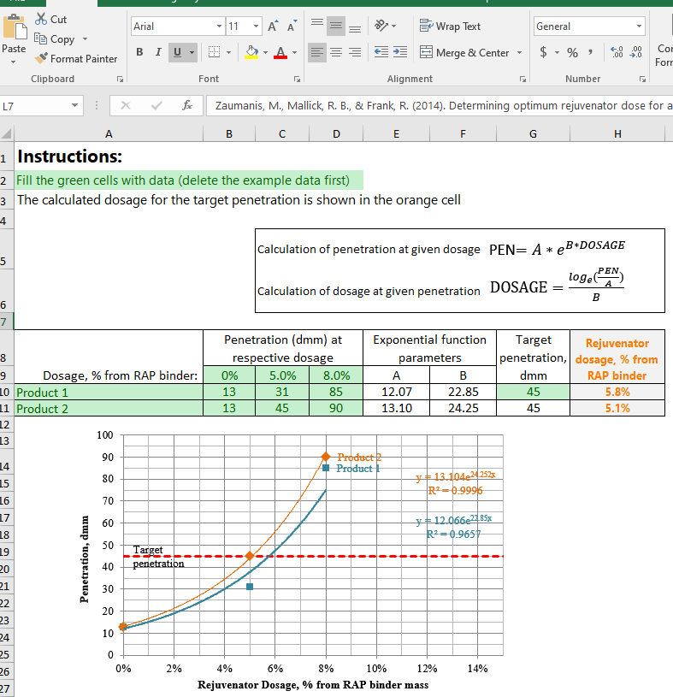
Calculator for determining dosage: https://doi.org/10.5281/zenodo.7441805

Slide 31
Mix design: Performance-based design

Slide 32
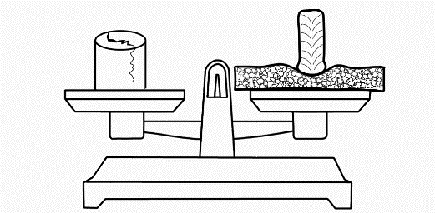
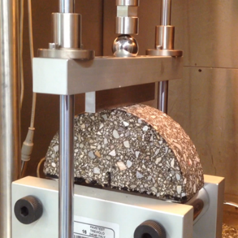
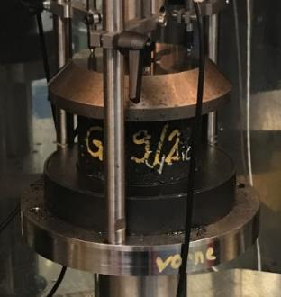
Pass-fail criteria developed
Rutting resistance:
Semi-Circular Bending test
Plastic deformations:
Cyclic compression test
Drawing Author: Martins Zaumans

Slide 33
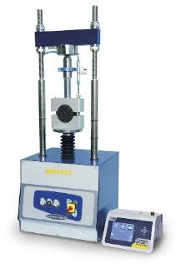

Example optimization of bitumen content

Slide 34
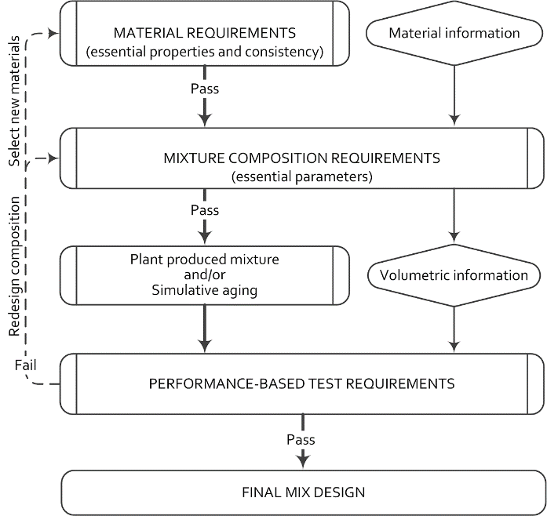
Performance-based mix design
Optimize the rejuvenator content for the mixtures based on target penetration results.
Use a cracking test and a plastic deformation test to balance the design binder content and other design parameters.
As needed, perform additional binder and mixture tests before approving the final designs.

Slide 35
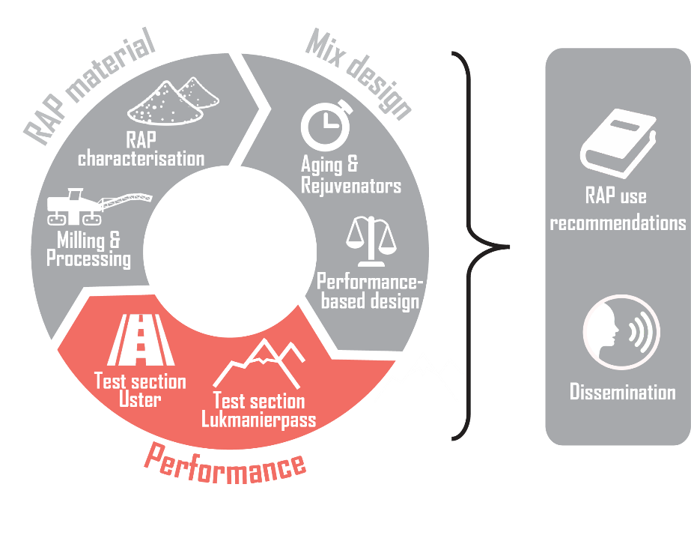
Test section: Uster

Slide 36
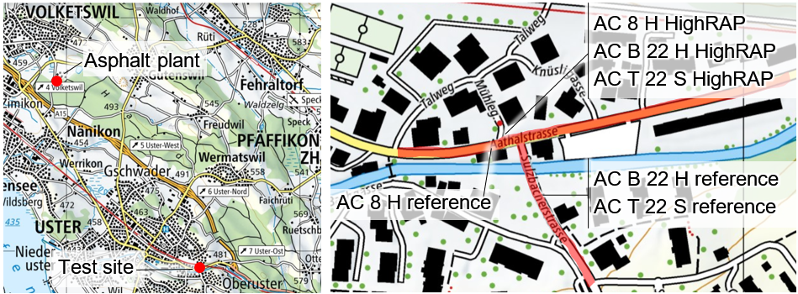
Location

Slide 37
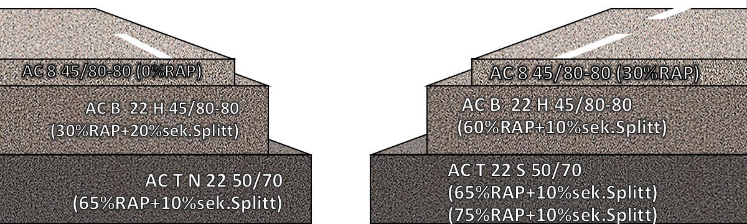
Mix types
Reference
HighRAP

Slide 38
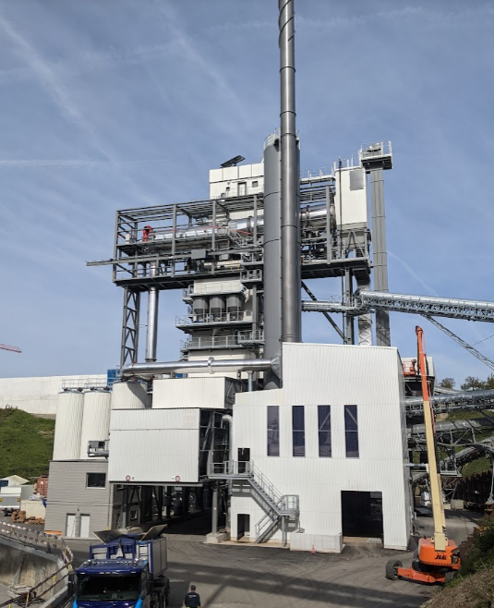
RAP was heated to production temperature in Ammann asphalt plant
Production: BHZ AG Asphalt plant in Volketswil
Rejuvenator added in the mixer

Slide 39
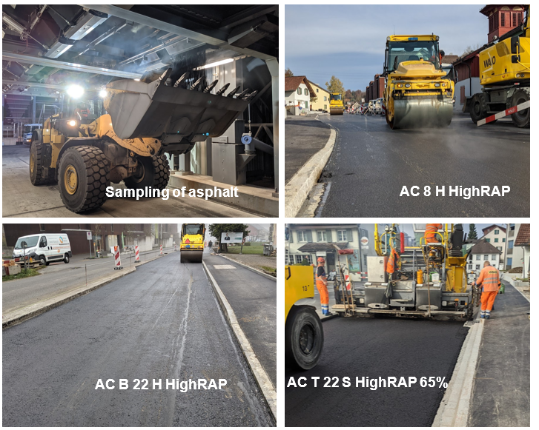

Video from construction
(https://youtu.be/MvyCwyrMNOs)

Slide 40

The produced mixtures were thoroughly characterized using mixture and binder tests

Slide 41
Summary

Slide 42
· 30 % RAP used in wearing course with good performance in PmB 45/80-80 grade; with 60% RAP not possible to reach this grade
· 40-50 % RAP likely allows to reach PmB 45/80-65 grade
· 65% RAP used in unmodified binder course—with good performance
Summary

Slide 43
Test section: Lukmanierpass

Slide 44
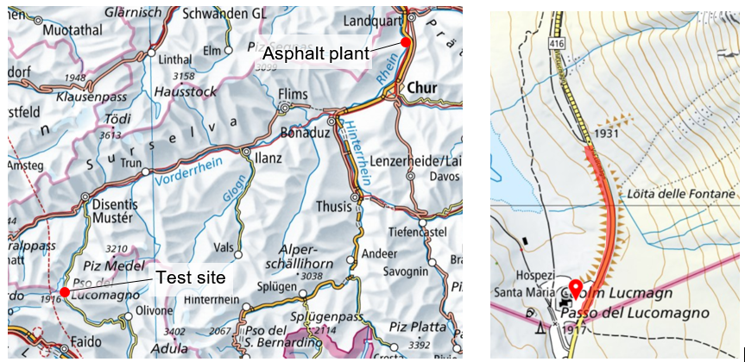
Location

Slide 45
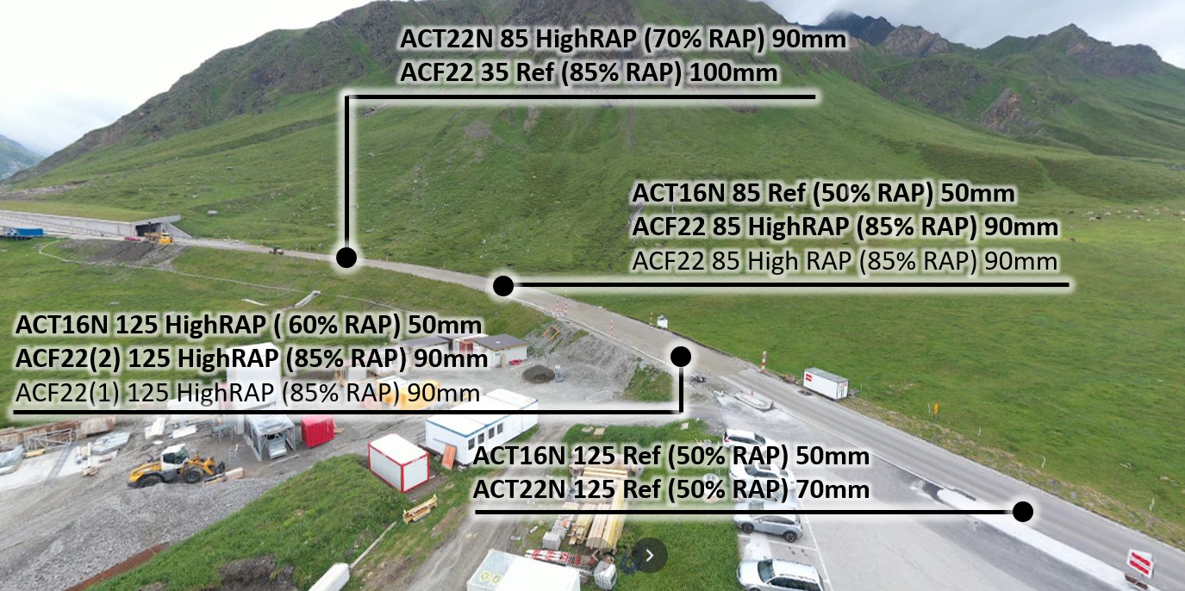
Mix types

Slide 46
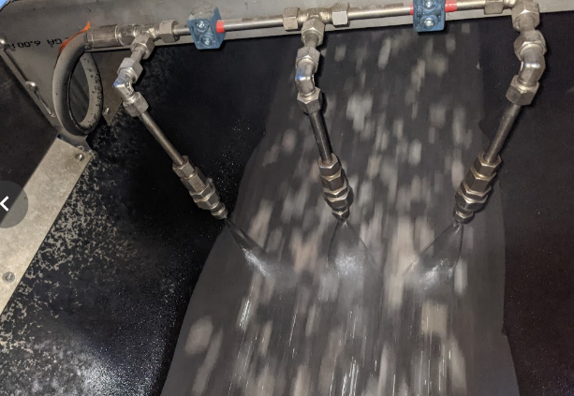
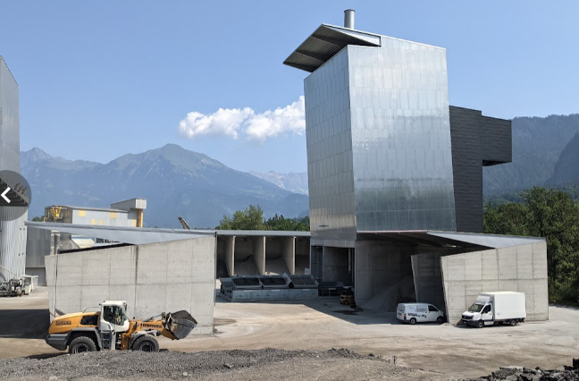
RAP heated to production temperature using Contimix RAH 100% and Ammann Universal 300
Production: Catram AG asphalt plant in Untervaz
Rejuvenator added on cold RAP

Slide 47
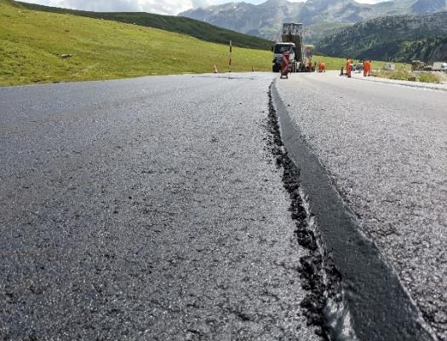

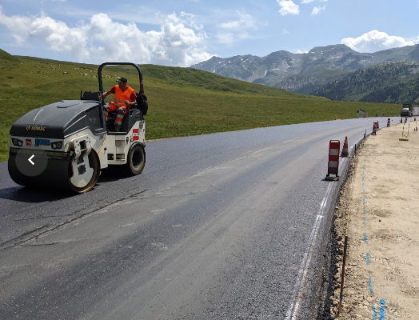

AC T 16 85 Ref
ACF22 85 HighRAP
ACF22 125 (1) HighRAP
Sample collection

Slide 48


1 year after construction: no problems

Slide 49
The produced mixtures were thoroughly characterized using mixture and binder tests

Slide 50
Summary

Slide 51
· 85 % RAP was used in foundation course mixtures with good performance
· 60-70 % RAP was used in base course with good performance
· Good thermal cracking resistance for all mixtures
Summary

Slide 52

Recommendations

Slide 53
Recommendations
· Use RAP ≤30 % in PmB wearing course (PmB 45/80-80) and ≤50 % in PmB base/binder course (PmB 45/80-65)
· Use RAP in high altitude ≤ 70 % in base/binder course and ≤85 % in foundation course
· (Higher RAP contents can be considered with proof of performance)
· Permit high RAP use only if high RAP homogeneity of RAP is ensured (especially binder content & properties)
· Use performance-based mix design for type testing (testing of cracking resistance is especially important)

Slide 54
Recommendations
· Select rejuvenator dosage based on target penetration
· Approve rejuvenator/soft binder by testing aging resistance (RTFO+2xPAV): test mass loss & penetration
· Ensure correspondence to conventional extracted binder & mixture test requirements
· Consider MSCR binder test for RAP use in PmB mixtures
· Use CBF indexes to optimize RAP crushing and screening
· Implement these recommendations after local validation

Slide 55
All results

Slide 56




Results of the HighRAP-Project
Report &
summary in DE, FR, EN
This Presentation
One-pager
Download
Excel-spreadsheets
Contact: martins.zaumanis@empa.ch
https://www.empa.ch/web/s308/highrap

